Slide 1
Unicorn Data Set
File created on: 12/15/2022 12:12:16 AM

Slide 2
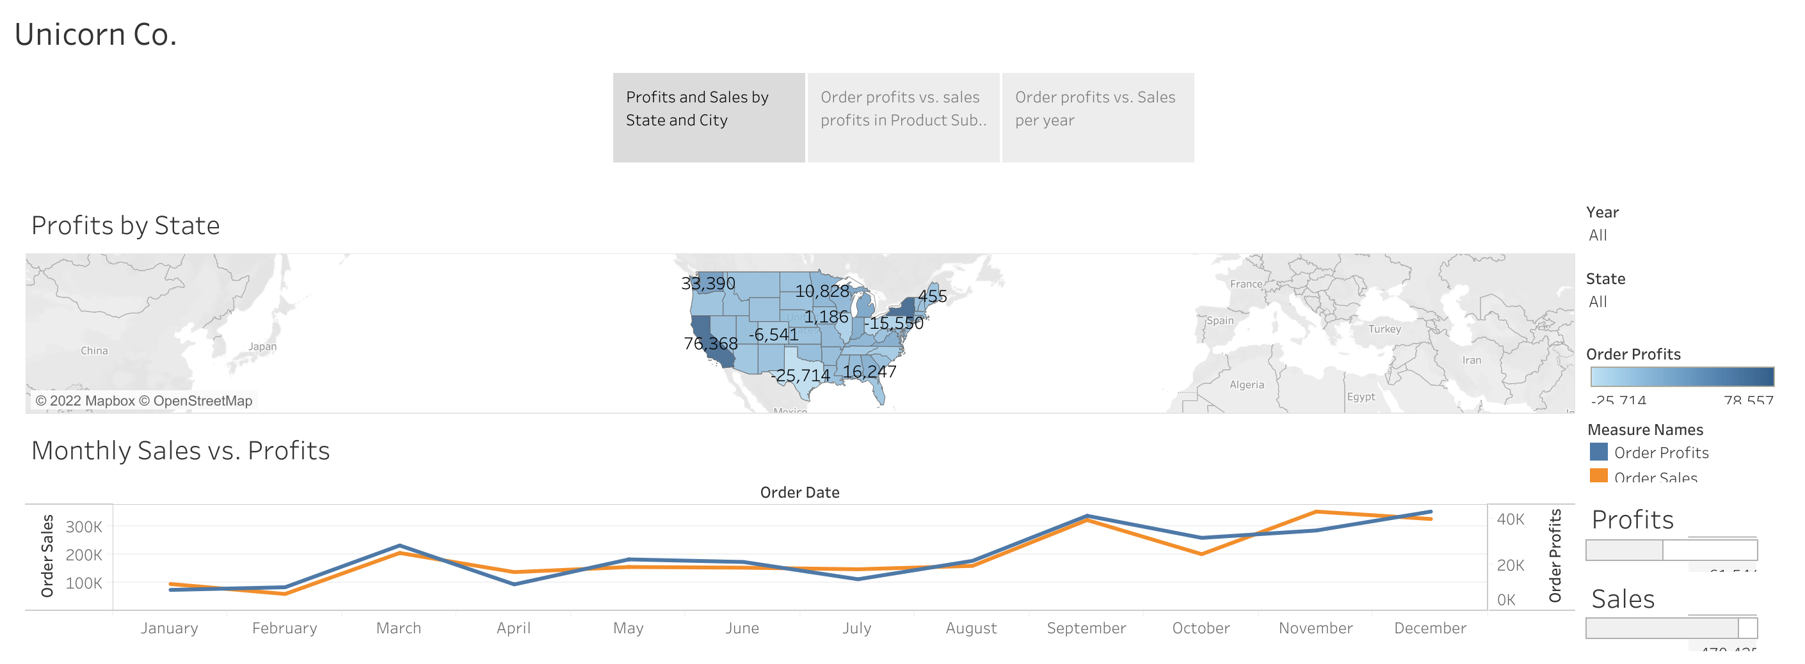

Slide 3
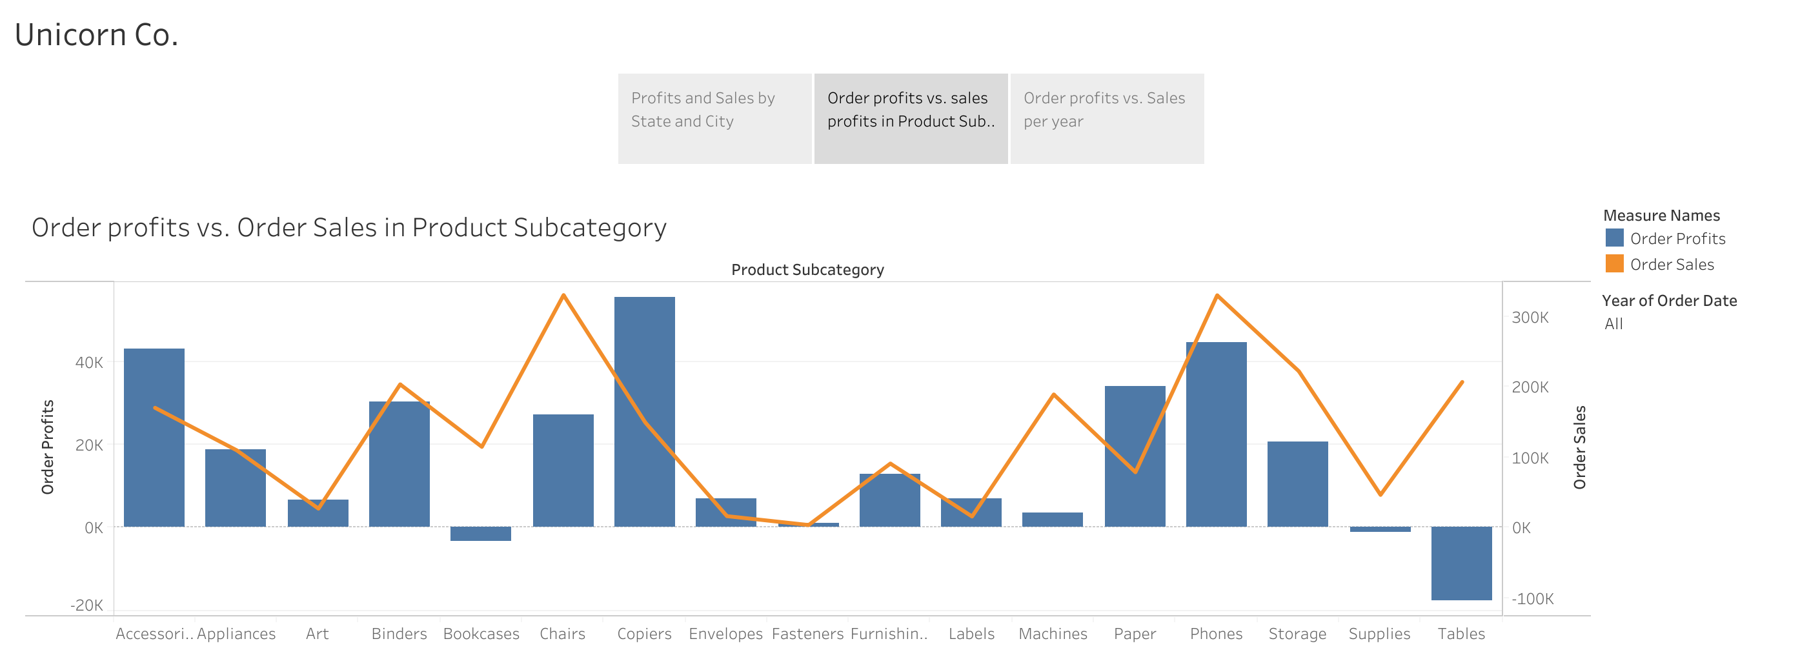

Slide 4
